Slide 1
Conservation of Procrastination: Do Productivity Interventions Save Time or Just Redistribute It?
Geza Kovacs, Drew Mylander Gregory, Zilin Ma, Zhengxuan Wu, Golrokh Emami, Jacob Ray, Michael S Bernstein
Stanford HCI Group
Notes:
II

Slide 2
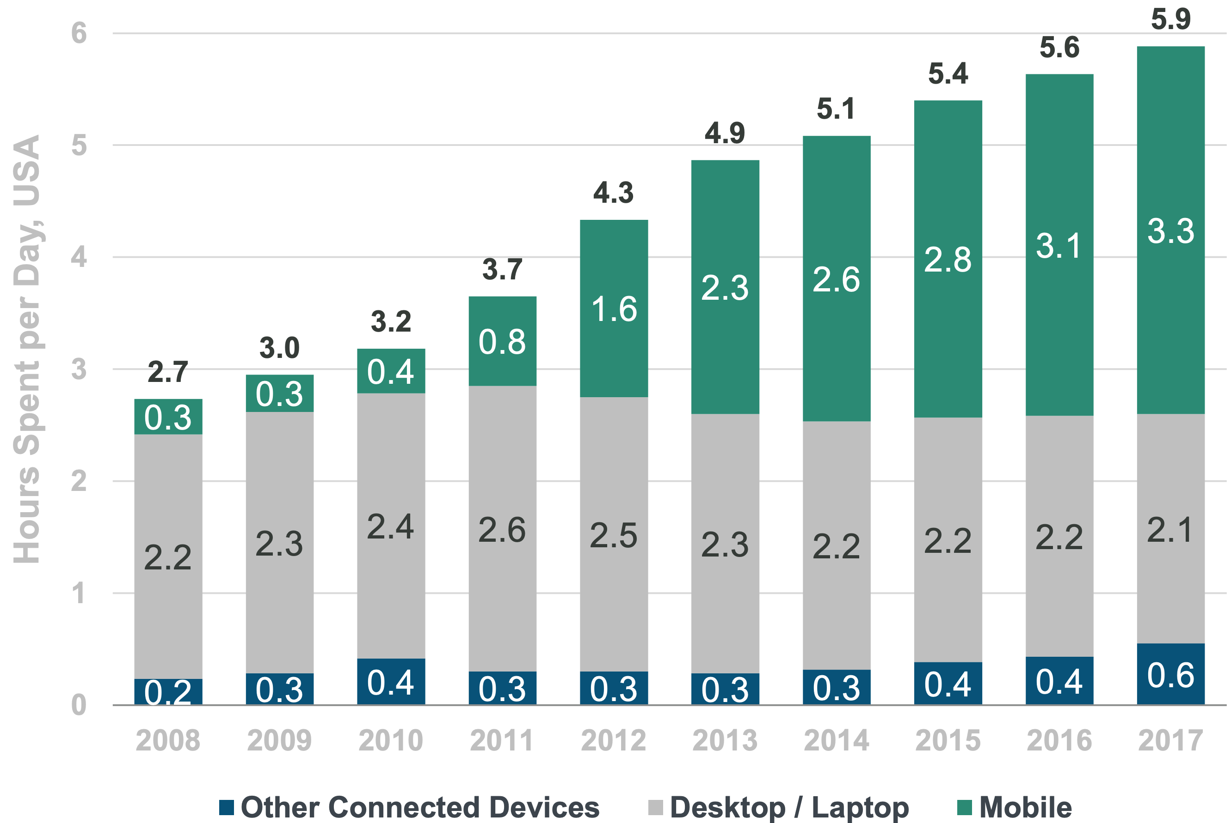
People spend increasing amounts of time online
Average US adult spends 5.9 hours per day with digital media
Source: Kleiner Perkins 2018 Internet Trends

Slide 3

People struggle to reduce their time online
Kim, Young-Ho, et al. "TimeAware: Leveraging framing effects to enhance personal productivity." Proceedings of the 2016 CHI Conference on Human Factors in Computing Systems. ACM, 2016.
Andreassen, Cecilie Schou, et al. "Development of a Facebook addiction scale." Psychological reports 110.2 (2012): 501-517.

Slide 4



Users use productivity tools to help them reduce time online

Slide 5
Is that time actually saved, or just redirected to other unproductive activities?

Slide 6

We often assume that intervention effects are isolated

Slide 7

We often assume that intervention effects are isolated

Slide 8
We often assume that intervention effects are isolated

Slide 9

We often assume that intervention effects are isolated

Slide 10


We often assume that intervention effects are isolated

Slide 11
What if the time you saved is just shifted elsewhere?

Slide 12

We have a limited supply of willpower
Laura Dabbish, Gloria Mark, and Víctor M González. 2011. Why do I keep interrupting myself?: Environment, Habit and Self-interruption. In Proceedings of the SIGCHI Conference on Human Factors in Computing Systems. ACM, 3127–3130.
Roy E Baumeister, Ellen Bratslavsky, Mark Muraven, and Dianne M Tice. 1998. Ego Depletion: Is the Active Self a Limited Resource? Journal of Personality and Social Psychology 74, 5 (1998), 1252–1265.
We need breaks and downtime

Slide 13
Is there a conservation-of-procrastination effect?
Does reducing time on one site or app increase time on others?

Slide 14
Is there a conservation-of-procrastination effect?
Does reducing time on one device increase time on others?

Slide 15
Do interventions have benefits outside the apps they were targeting?

Slide 16
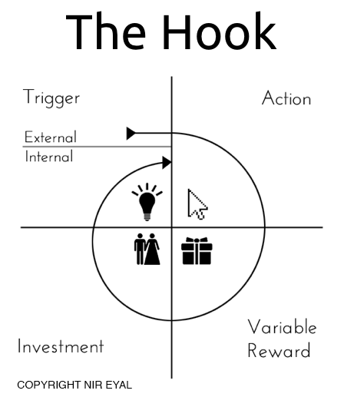
Apps are designed to be habit-building
Results in habit loop of constantly visiting sites or checking phones

Slide 17
Does breaking habit loops result in further decreases in time spent elsewhere?
Does reducing time on one app or site decrease time on others?

Slide 18
Does breaking habit loops result in further decreases in time spent elsewhere?
Does reducing time on one device decrease time on the other?

Slide 19
RQ1: Do interventions on one site or app influence time spent on other sites and apps?

Slide 20
RQ1: Do interventions on one site or app influence time spent on other sites and apps?

Slide 21
RQ1: Do interventions on one site or app influence time spent on other sites and apps?
Isolation
Redistribution
Reduction

Slide 22
RQ2: Do interventions on one device influence time spent on other devices?
Isolation
Redistribution
Reduction

Slide 23
Outline
Our behavior change system (HabitLab)
Are interventions effective at reducing time on the focal goal?
RQ1: Is time redistributed to other sites on the same platform?
RQ2: Is time redistributed across devices?

Slide 24
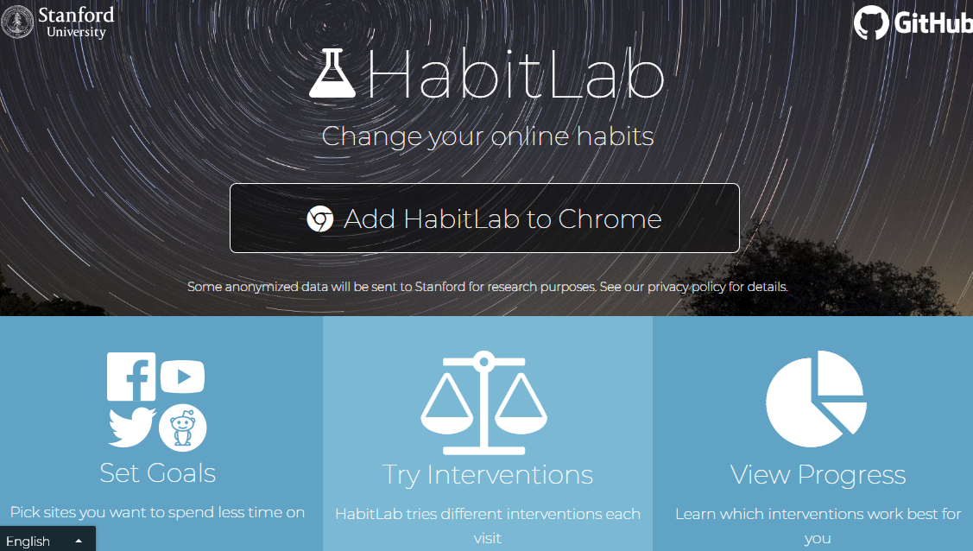
HabitLab
Our behavior change platform
12,000+ in-the-wild active users (Browser+Android)

Slide 25
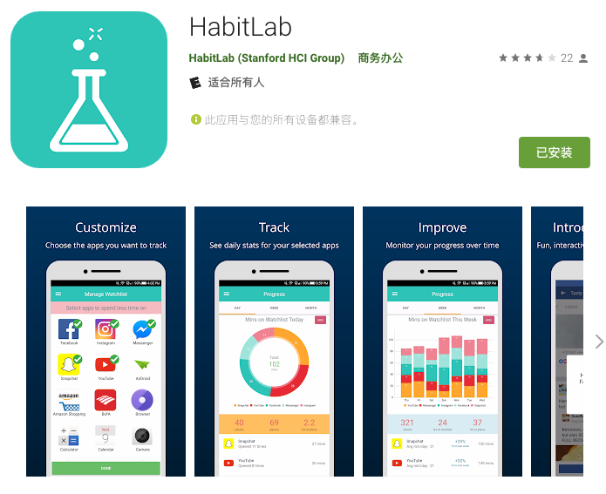
HabitLab
Our behavior change platform
12,000+ in-the-wild active users (Browser+Android)

Slide 26
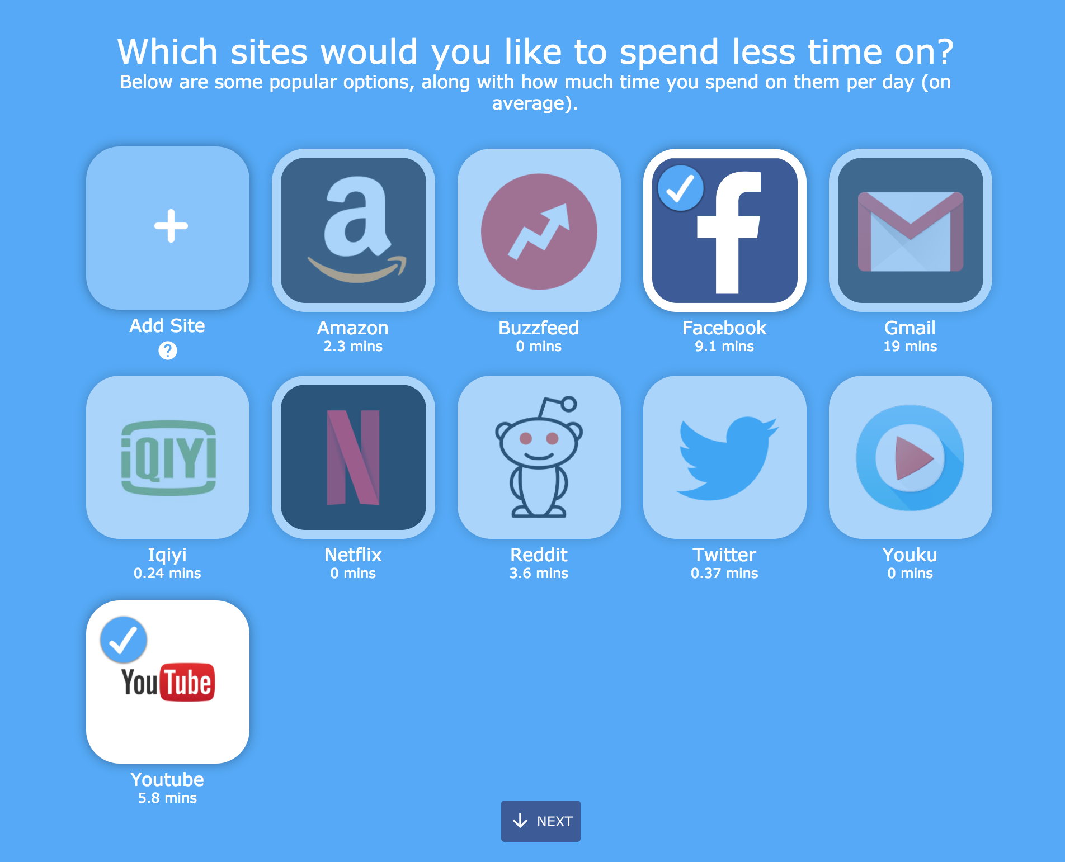
Users select sites or apps to reduce time on (goals)

Slide 27
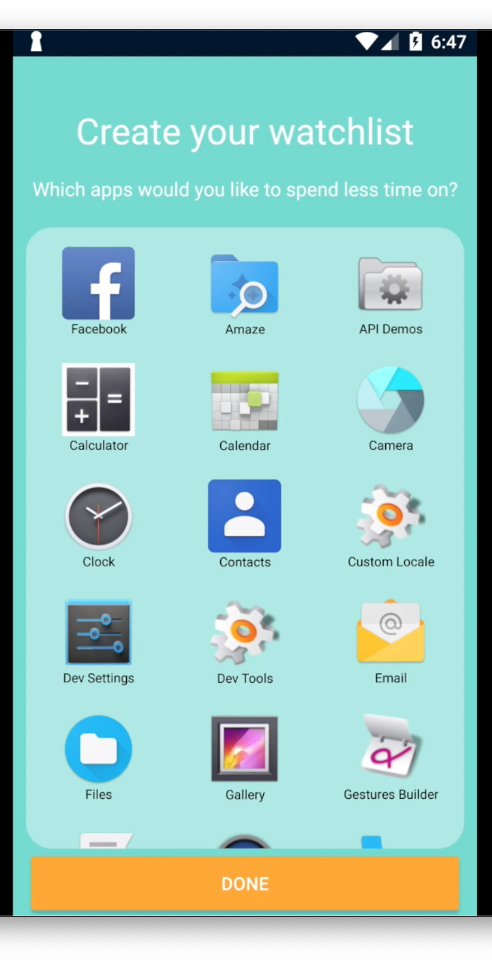
Users select sites or apps to reduce time on (goals)

Slide 28
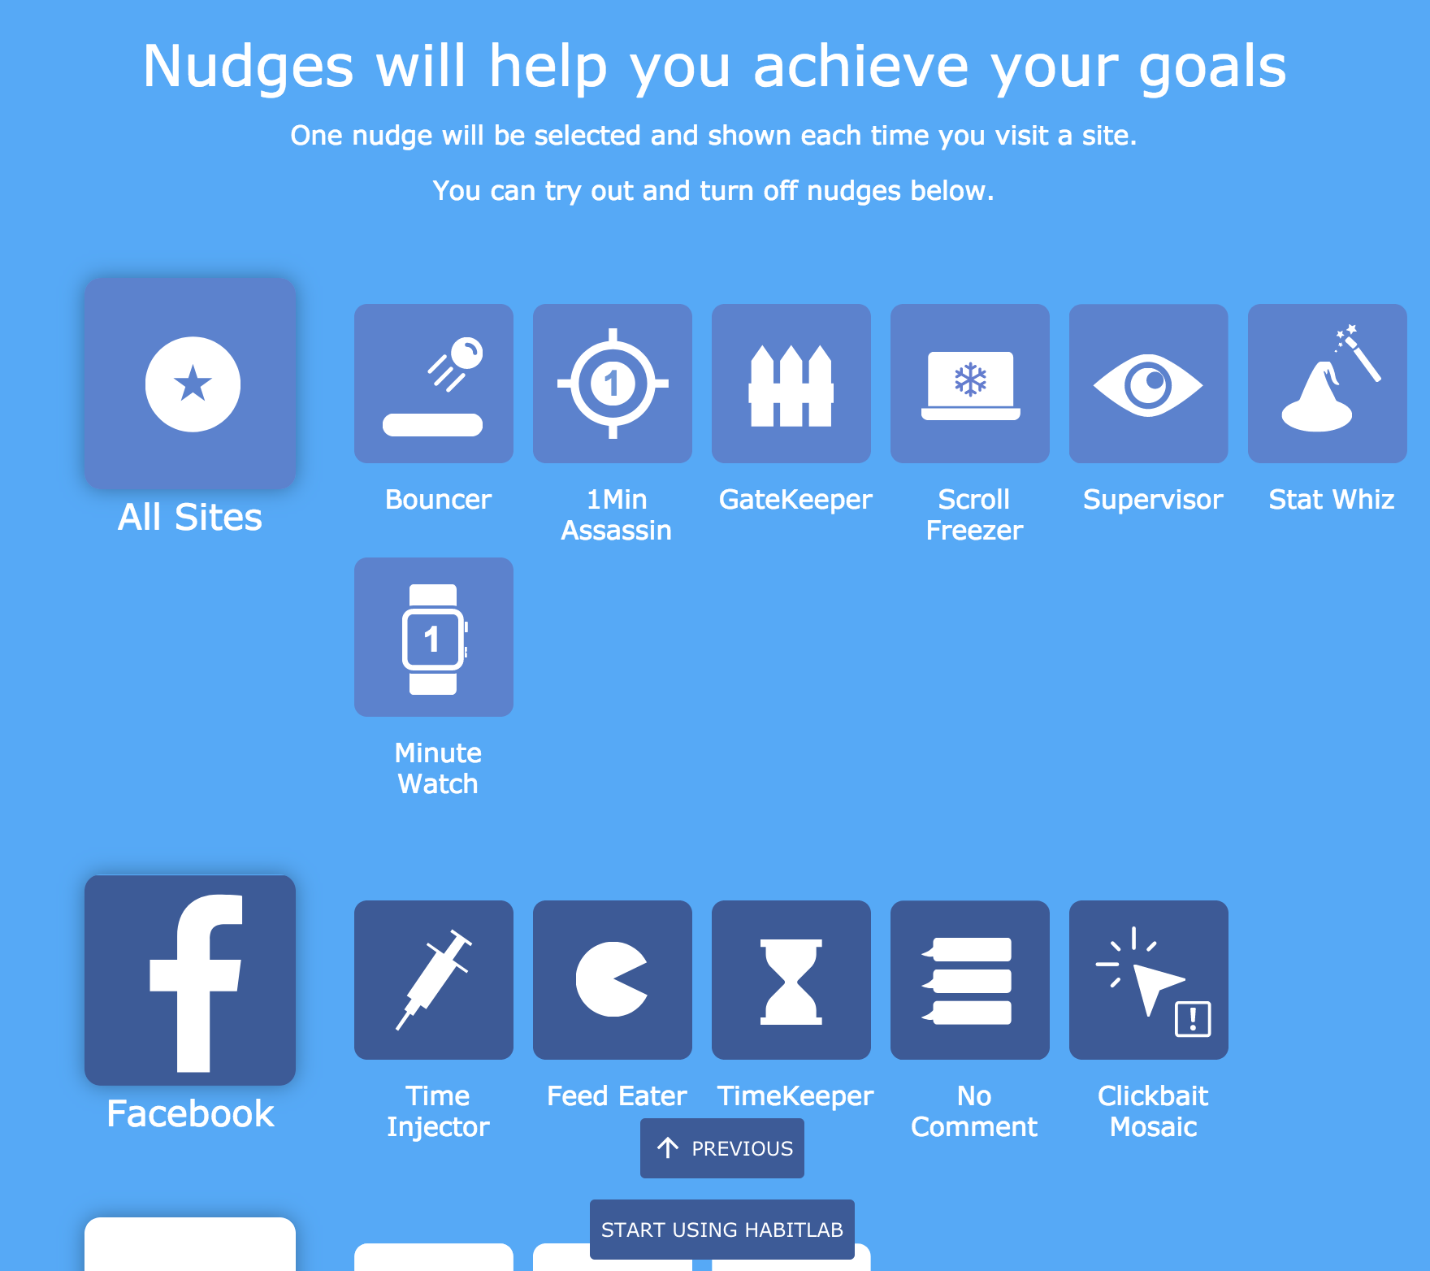
Interventions help reduce time on goal sites and apps

Slide 29
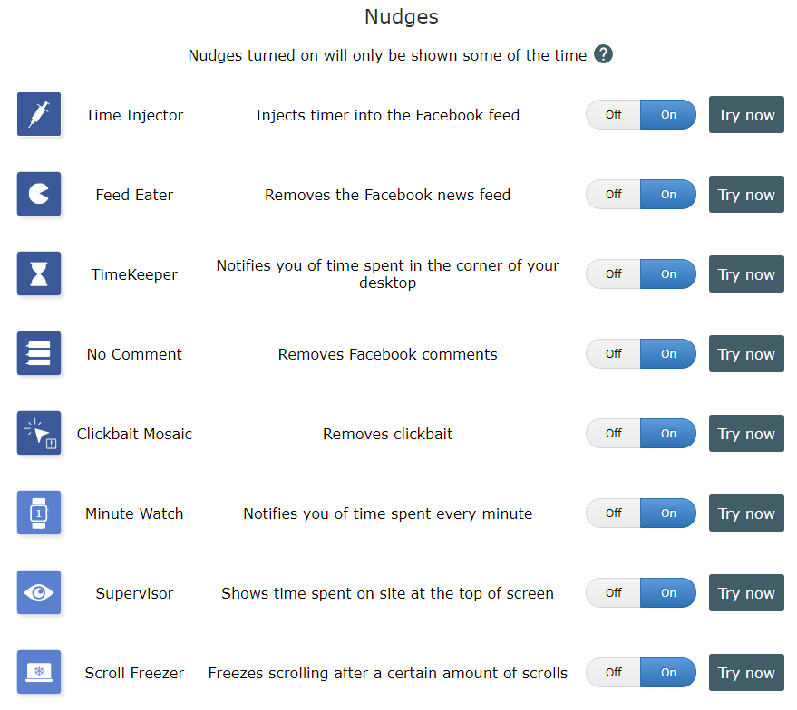
30+ interventions available

Slide 30
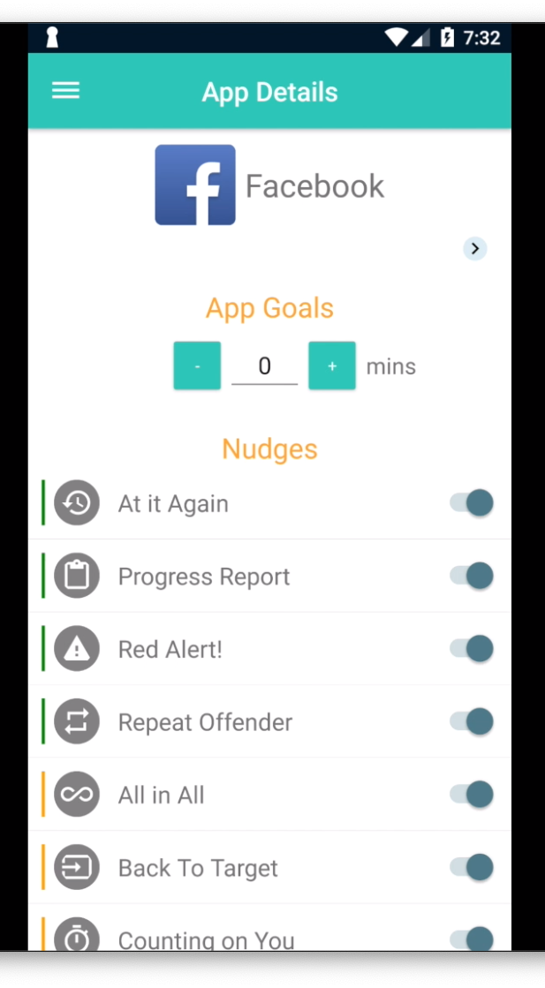
30+ interventions available

Slide 31

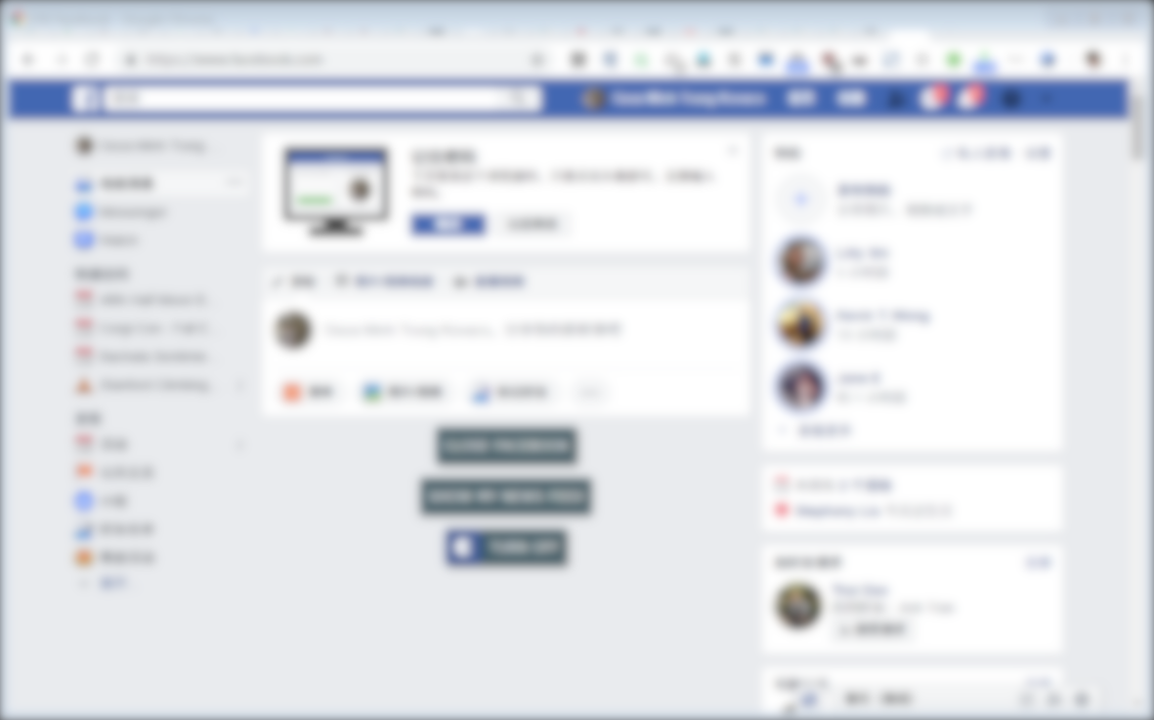


Slide 32
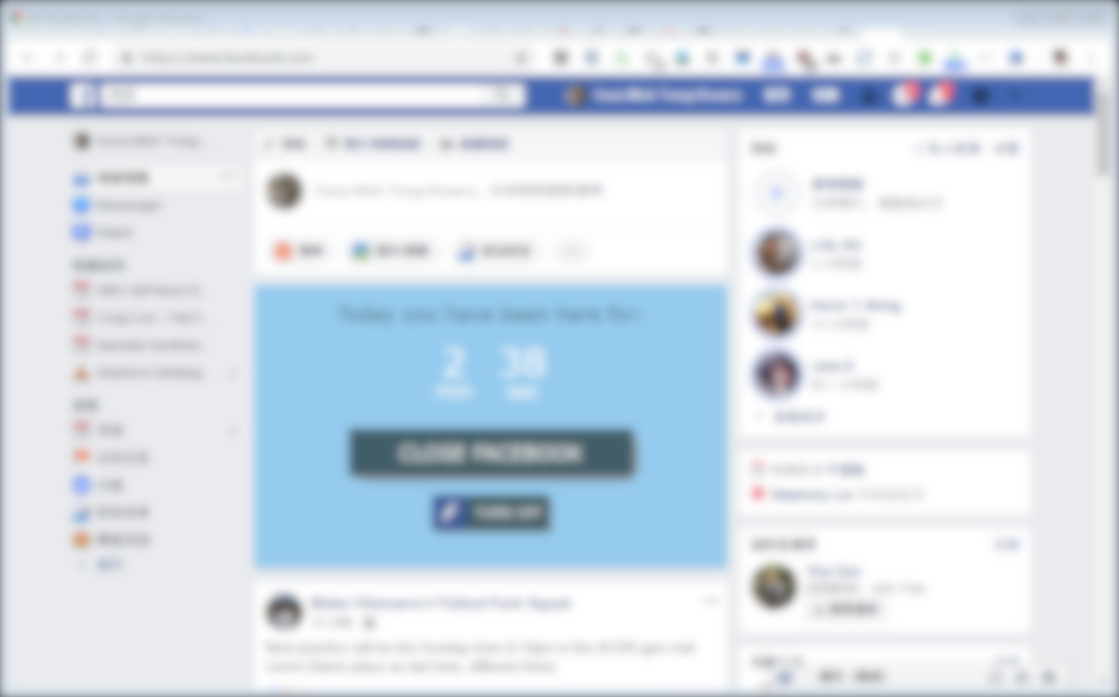
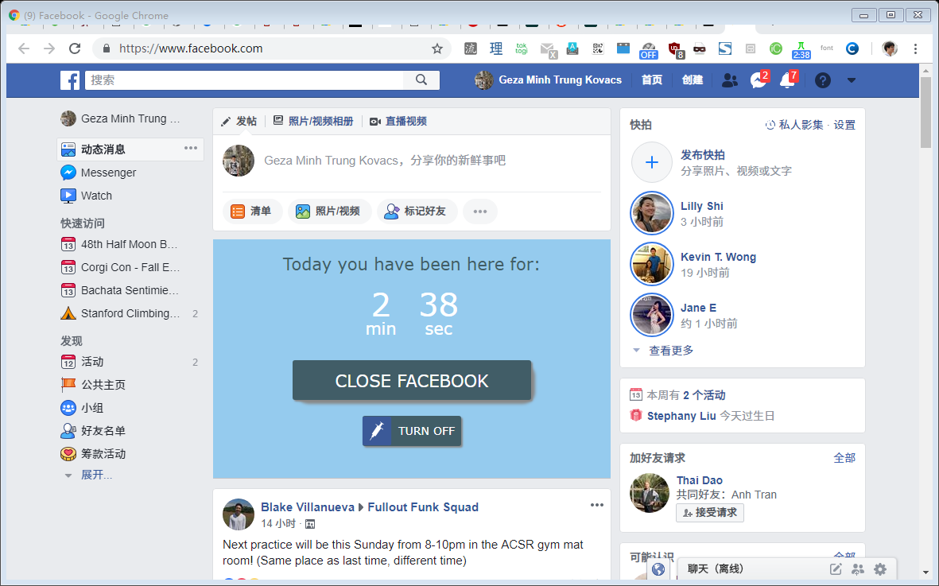

Slide 33
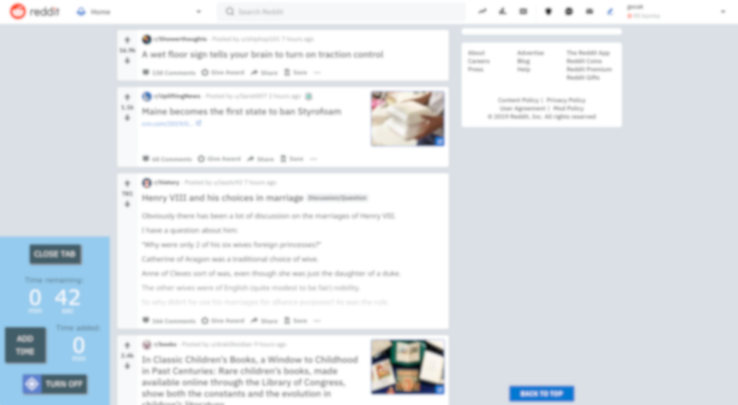
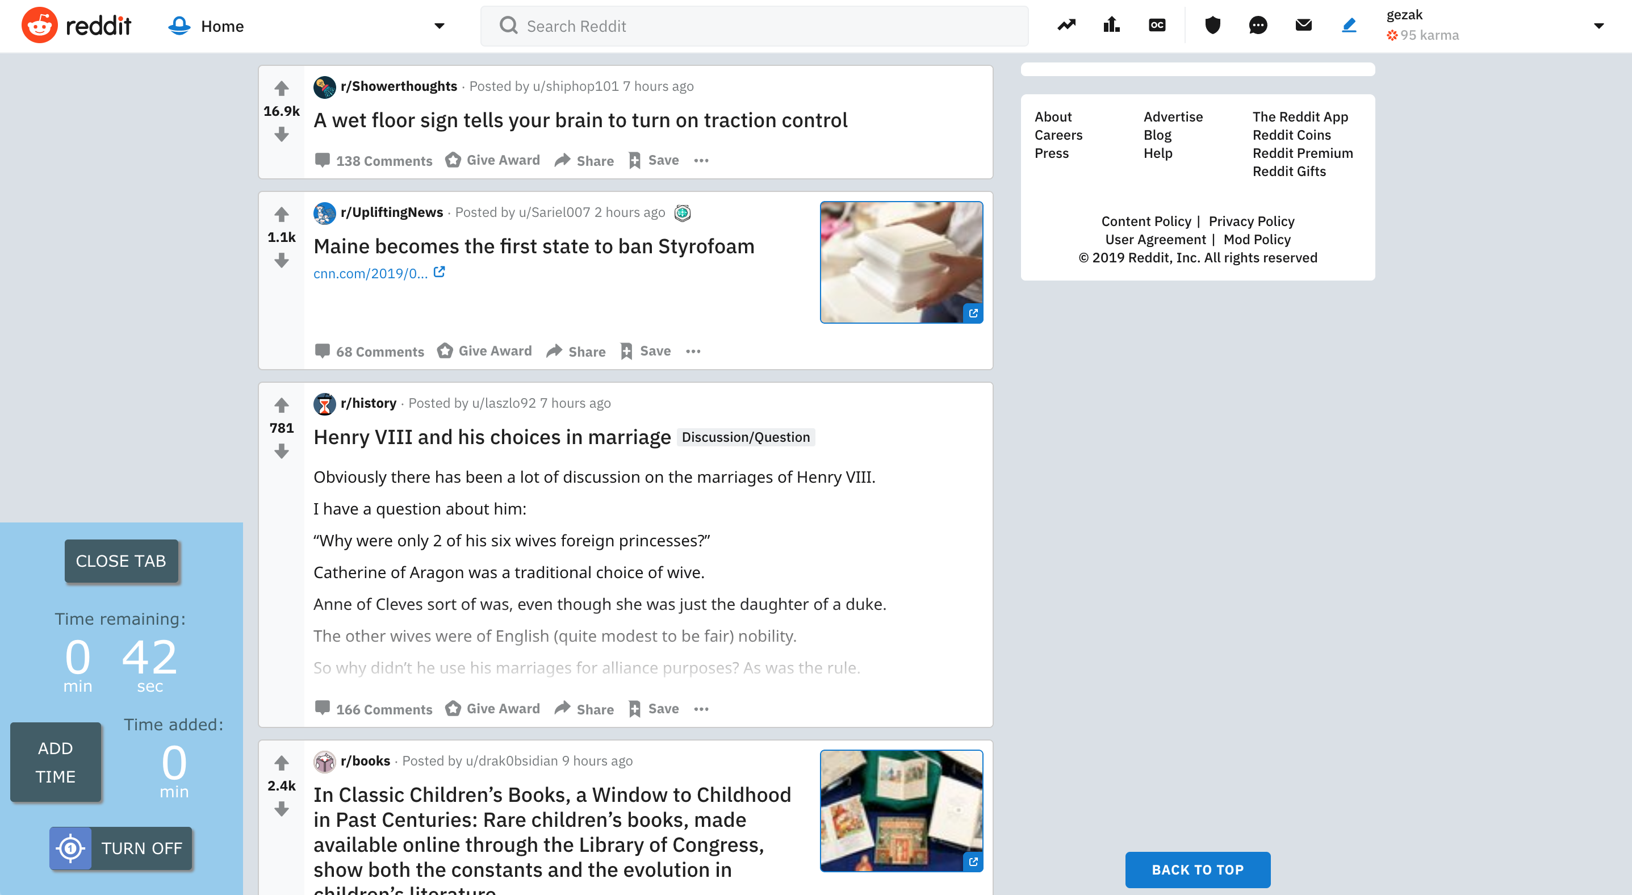

Slide 34

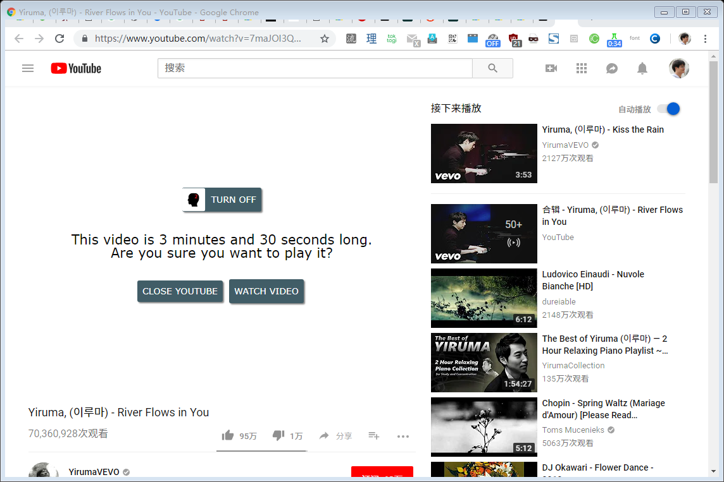

Slide 35
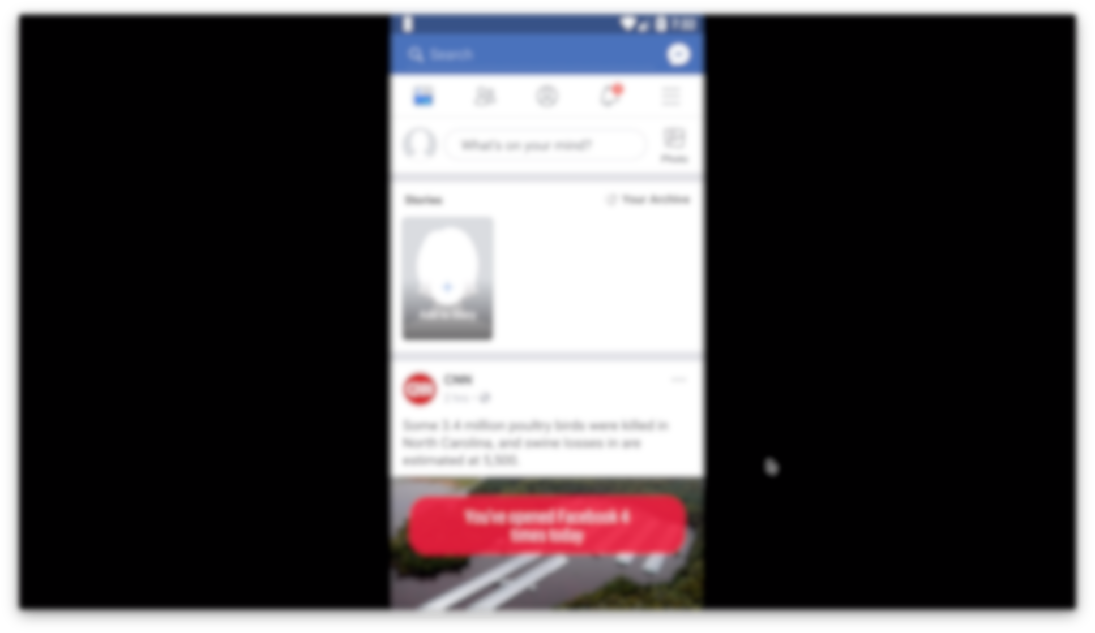
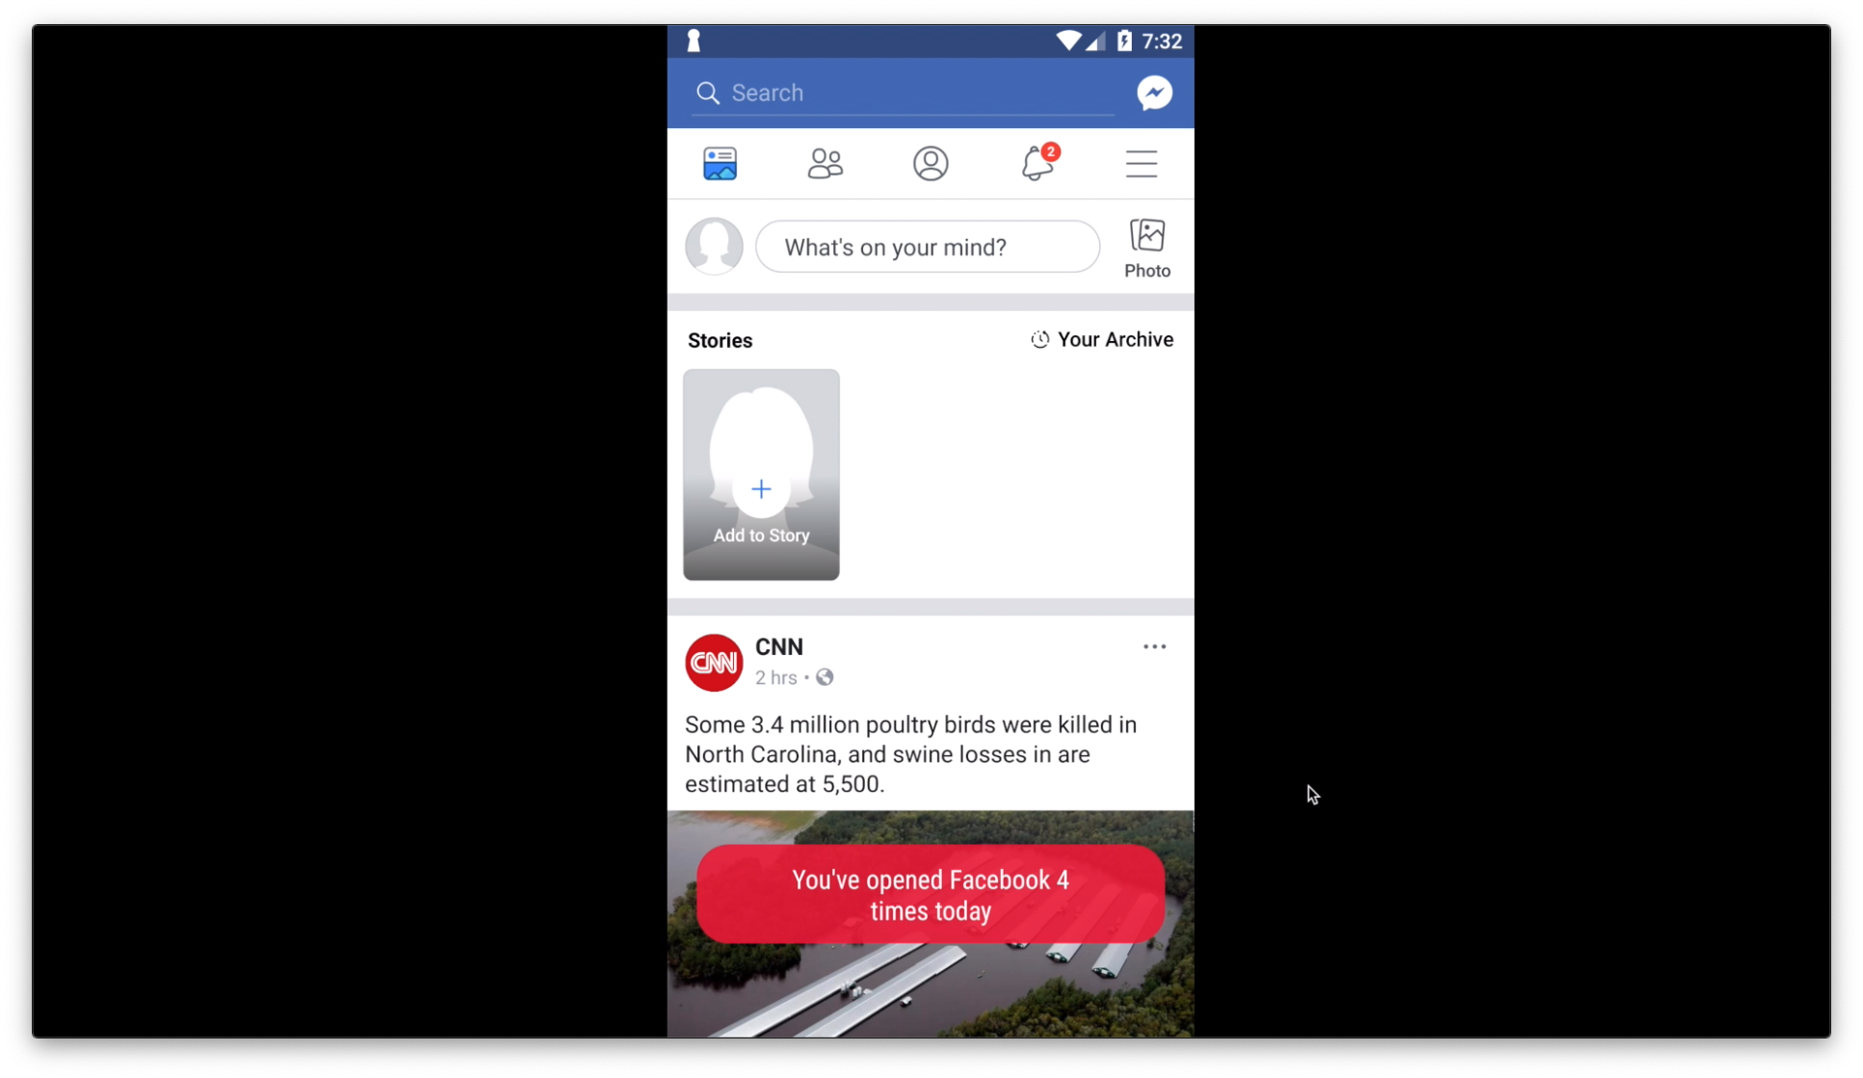

Slide 36
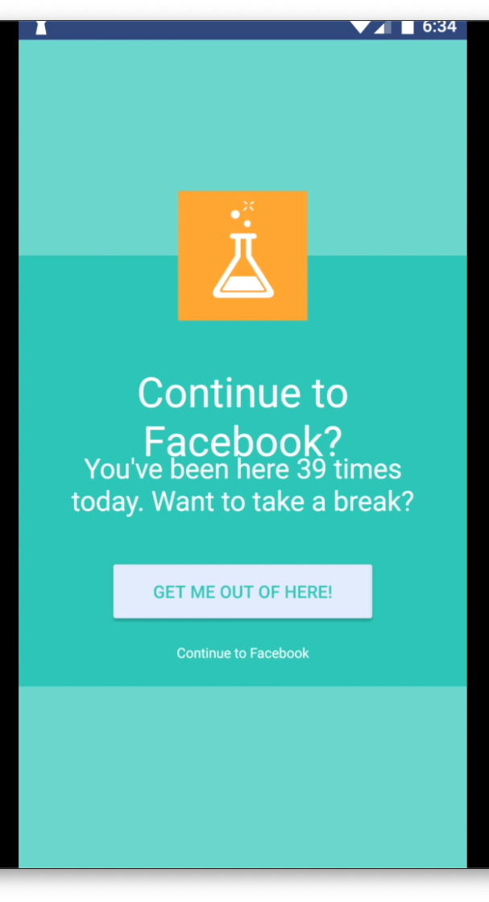

Slide 37
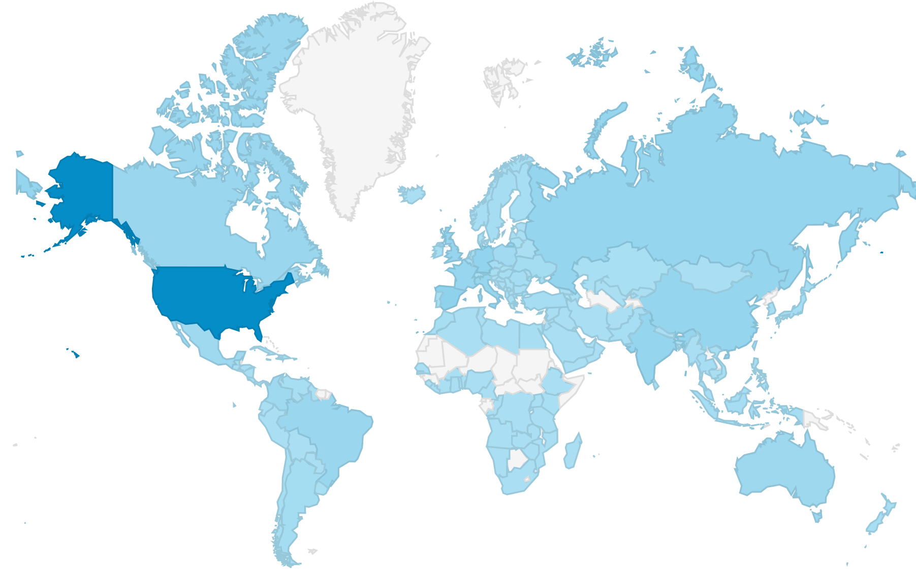
Over 12,000 daily active users from 151 countries

Slide 38
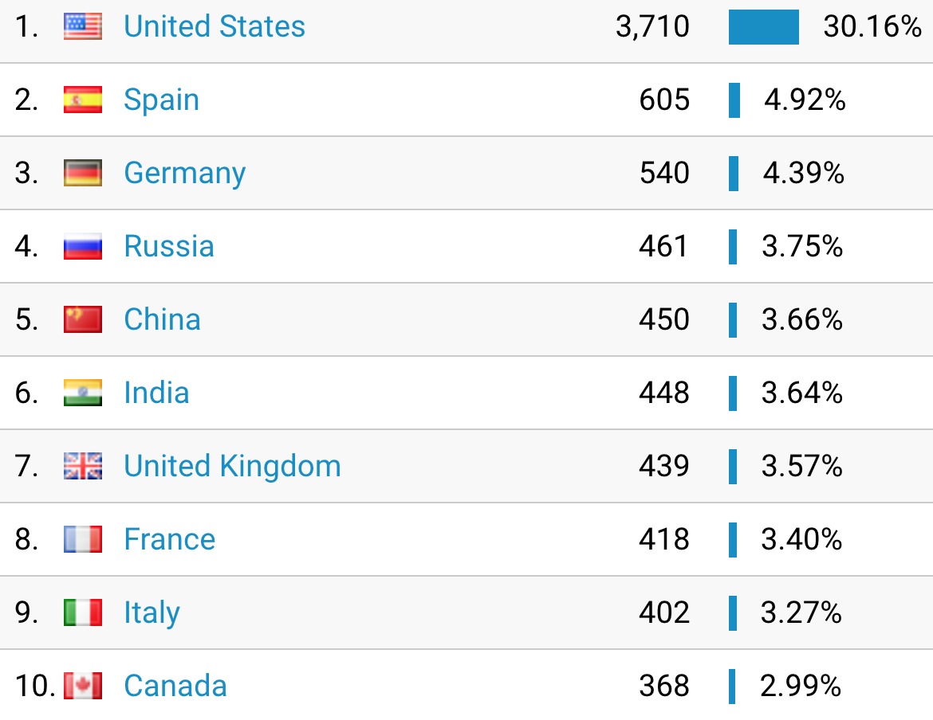

Slide 39
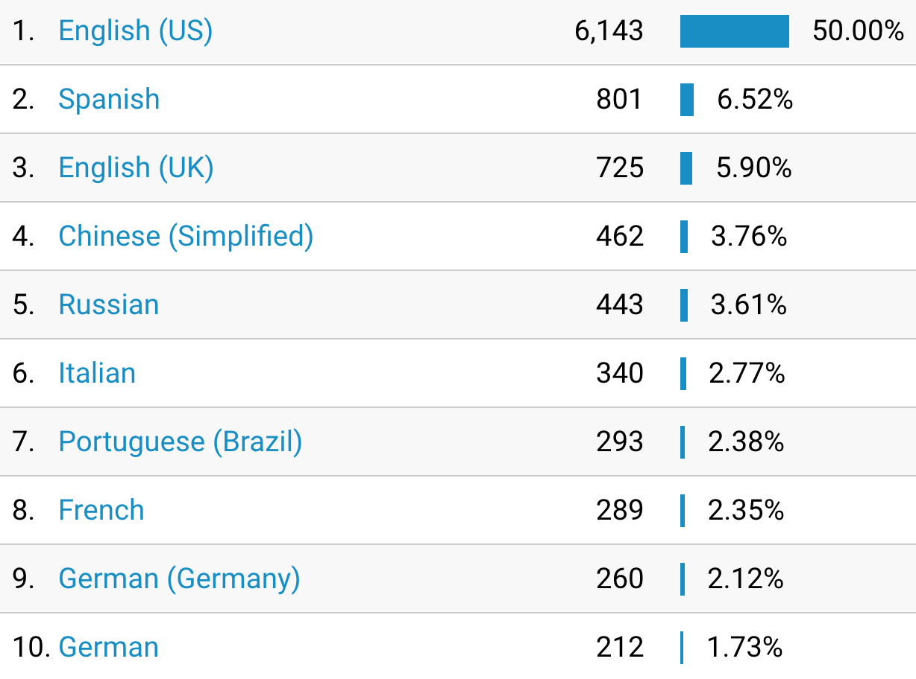

Slide 40
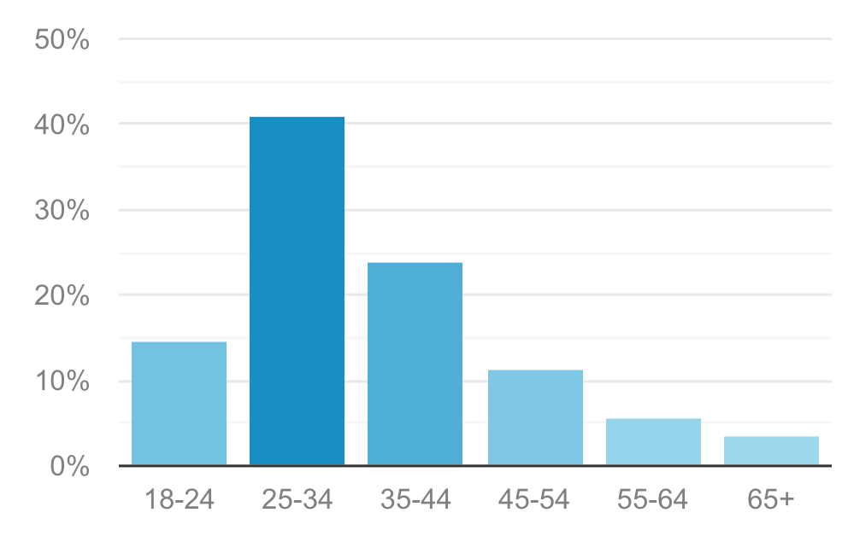

Slide 41
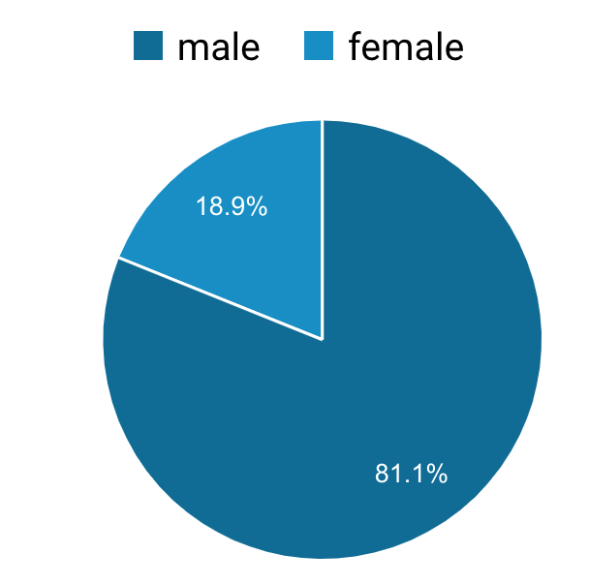

Slide 42
Outline
Our behavior change system (HabitLab)
Are interventions effective at reducing time on the focal goal?
RQ1: Is time redistributed to other sites on the same platform?
RQ2: Is time redistributed across devices?

Slide 43
Are interventions effective? (Method)
For each goal, we randomly assign it to one of 2 conditions each week:
Frequent
An intervention is shown every visit
(each site visit for browser, each app visit on android)
Infrequent
An intervention is shown on 20% of visits

Slide 44
Are interventions effective? (Method)
Compare daily time spent on days in the frequent vs infrequent conditions, for each goal

Slide 45
Are interventions effective? (Method)
Compare daily time spent on days in the frequent vs infrequent conditions, for each goal
5.8 weeks with 1034 users on browser (n=22,462 days), and 876 users on mobile (n=26,273 days)

Slide 46
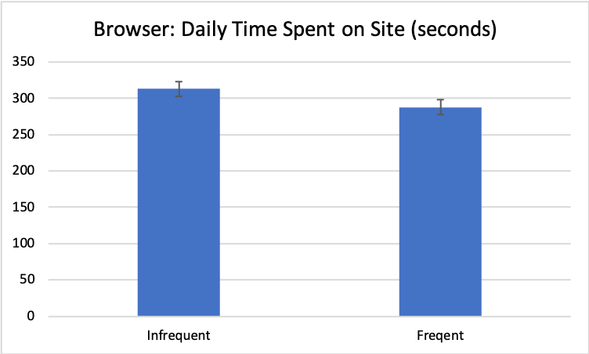
Interventions are effective on both platforms
7.3% reduction in daily time spent on browser version, on frequent weeks. Statistically significant (p < 0.001)

Slide 47
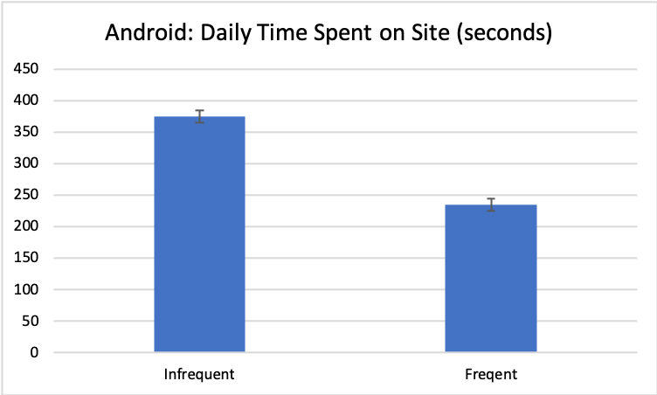
Interventions are effective on both platforms
37.2% reduction in daily time spent on android version, on frequent weeks. Statistically significant (p < 0.001)

Slide 48
Outline
Our behavior change system (HabitLab)
Are interventions effective at reducing time on the focal goal?
Effective on both browser and mobile
RQ1: Is time redistributed to other sites on the same platform?
RQ2: Is time redistributed across devices?

Slide 49
Outline
Our behavior change system (HabitLab)
Are interventions effective at reducing time on the focal goal?
Effective on both Browser and Android
RQ1: Is time redistributed to other sites on the same platform?
RQ2: Is time redistributed across devices?

Slide 50
Is time redistributed within platform? (Method)
We developed a metric of how intense interventions are this day (intensity)
Percentage of sessions on a goal that triggered an intervention

Slide 51
Is time redistributed within platform? (Method)
We developed a metric of how intense interventions are this day (intensity)
Percentage of sessions on a goal that triggered an intervention.
E.g. if visited Facebook 10x, and saw 0 interventions, then intensity=0
Intensity=0

Slide 52
Is time redistributed within platform? (Method)
We developed a metric of how intense interventions are this day (intensity)
Percentage of sessions on a goal that triggered an intervention.
E.g. if visited Facebook 10x, and saw 3 interventions, then intensity=0.3
Intensity=0.3

Slide 53
Is time redistributed within platform? (Method)
We developed a metric of how intense interventions are this day (intensity)
Percentage of sessions on a goal that triggered an intervention.
Verified that on days where intensity is higher, overall total time on goal sites is significantly lower on both platforms
Intensity=0.3

Slide 54
Is time redistributed within platform? (Method)
To manipulate intensity, we randomly assign each goal to have either frequent or infrequent interventions each week, resulting in a continuous intensity value from 0 to 1
Frequent
An intervention is shown every visit
(each site visit for browser, each app visit on android)
Infrequent
An intervention is shown on 20% of visits

Slide 55
Is time redistributed within platform? (Method)
On days when intensity is higher, what is the effect on the time spent on non-goal apps and sites?
LMM (Linear Mixed Model) structure
Dependent variable | Total time on non-goal sites (log)
Fixed effects | Intensity
Random effects | User

Slide 56
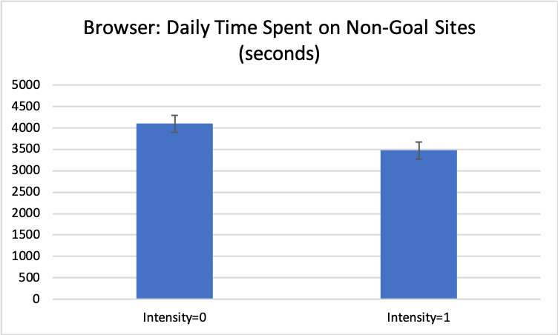
Browser: reduction of time spent on other sites when intensity is higher
15% reduction in time spent when intensity increases from 0→1 (p < 0.0001)

Slide 57
Mobile: No significant effect of time on one app on other apps

Slide 58
RQ1: Do interventions on one site/app influence time spent on other sites/apps?
Isolation
Conservation
Reduction

Slide 59
RQ1: Do interventions on one site/app influence time spent on other sites/apps?
Isolation
Conservation
Reduction
Browser

Slide 60
RQ1: Do interventions on one site/app influence time spent on other sites/apps?
Isolation
Mobile
Conservation
Reduction
Browser

Slide 61



Why was there a reduction effect on browser?
Aggregator sites such as Facebook often link to other domains
By reducing visits and time on Facebook, we reduce time on other domains

Slide 62



Why was there no effect on mobile?
Mobile goal apps were mostly messaging-oriented, not aggregators
Sessions were short and followed by turning off the screen
Screen off
Oulasvirta, Antti, et al. "Interaction in 4-second bursts: the fragmented nature of attentional resources in mobile HCI." Proceedings of the SIGCHI conference on Human factors in computing systems. ACM, 2005.

Slide 63
Why was there no effect on mobile?
Many mobile apps such as Facebook embed an in-app browser, so visiting external links remains within the same app
Screen off

Slide 64
Outline
Our behavior change system (HabitLab)
Are interventions effective at reducing time on the focal goal?
Effective on both browser and mobile
RQ1: Is time redistributed to other sites on the same platform?
Reducing time on one site reduces time elsewhere on browser (reduction hypothesis), but not mobile (isolation hypothesis)
RQ2: Is time redistributed across devices?

Slide 65
Outline
Our behavior change system (HabitLab)
Are interventions effective at reducing time on the focal goal?
Effective on both browser and mobile
RQ1: Is time redistributed to other sites on the same platform?
Reducing time on one site reduces time elsewhere on browser (reduction hypothesis), but not mobile (isolation hypothesis)
RQ2: Is time redistributed across devices?

Slide 66
Is time redistributed across devices? (Method)
On days when intensity is higher on one device, what is the effect on total time spent on goal sites on the other device?

Slide 67
Is time redistributed across devices? (Method)
On days when intensity is higher on one device, what is the effect on total time spent on goal sites on the other device?
Limited to participants using HabitLab on both platforms (60 participants, n=429 days)

Slide 68
Is time redistributed across devices? (Method)
On days when intensity is higher on one device, what is the effect on total time spent on goal sites on the other device?
Limited to participants using HabitLab on both platforms (60 participants, n=429 days)
LMM (Linear Mixed Model) structure
Dependent variable | Total time on other device (log)
Fixed effects | Intensity on this device
Random effects | User

Slide 69
Time is not redistributed across devices
Effects of browser intensity on mobile: No significant effect (p>.5)
Effects of mobile intensity on browser: No significant effect (p>.5)

Slide 70
RQ2: Do interventions on one device influence time spent on other devices?
Isolation
Redistribution
Reduction

Slide 71
RQ2: Do interventions on one device influence time spent on other devices?
Isolation
Mobile → Browser
Browser → Mobile
Redistribution
Reduction

Slide 72
Why were there no cross-device effects?
Laptops and phones are used in different contexts
Unlike browsers, there are no cross-device “links” – few apps/sites prompt you to start using the other device

Slide 73
Outline
Our behavior change system (HabitLab)
Are interventions effective at reducing time on the focal goal?
Effective on both browser and mobile
RQ1: Is time redistributed to other sites on the same platform?
Reducing time on one site reduces time elsewhere on browser (reduction hypothesis), but not mobile (isolation hypothesis)
RQ2: Is time redistributed across devices?
Time is not redistributed across devices (isolation hypothesis)

Slide 74
Discussion and implications
We did not observe negative secondary effects of productivity interventions (on other apps, sites, or devices)
On browsers, there’s actually a reduction elsewhere, from reducing time on sites (likely due to aggregator sites)

Slide 75
Discussion and implications
When designing interventions, we should consider effects not just on the targeted behavior, but the workflow as a whole

Slide 76
Limitations
Only monitoring time on phones and browsers
Cannot observe if time is being redistributed to non-digital activities
Only studied productivity domain
“Absence of negative secondary effects” may not generalize to other behavior change domains

Slide 77
Conclusion
Does reducing time via interventions influence time spent elsewhere?

Slide 78
Conclusion
Isolation
Does reducing time via interventions influence time spent elsewhere?
Within-device: reduction on browser
Redistribution
Reduction
Browser

Slide 79
Conclusion
Isolation
Mobile
Does reducing time via interventions influence time spent elsewhere?
Within-device: reduction on browser, but not mobile
Redistribution
Reduction
Browser

Slide 80
Conclusion
Isolation
Mobile → Browser
Browser → Mobile
Does reducing time via interventions influence time spent elsewhere?
Within-device: reduction on browser, but not mobile
Cross-device: no effects
Redistribution
Reduction

Slide 81
Conclusion
Does reducing time via interventions influence time spent elsewhere?
Within-device: reduction on browser, but not mobile
Due to aggregator sites driving traffic to other sites
Cross-device: no effects

Slide 82
Conclusion
Does reducing time via interventions influence time spent elsewhere?
Within-device: reduction on browser, but not mobile
Due to aggregator sites driving traffic to other sites
Cross-device: no effects
Devices used in different contexts

Slide 83
Conservation of Procrastination:
Do Productivity Interventions Save Time
or Just Redistribute It?
Geza Kovacs
geza@cs.stanford.edu
Does reducing time via interventions influence time spent elsewhere?
Within-device: reduction on browser, but not mobile
Due to aggregator sites driving traffic to other sites
Cross-device: no effects
Devices used in different contexts
https://habitlab.github.io

Slide 84
Backup Slides

Slide 85
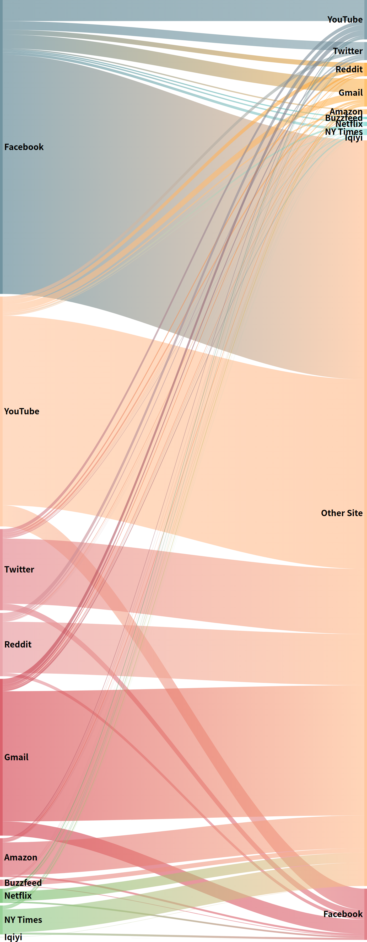
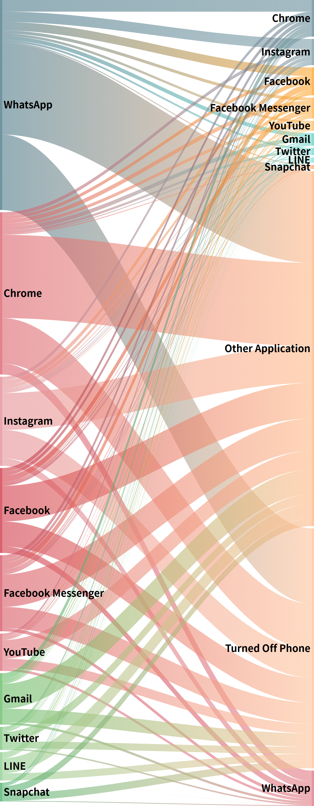

Slide 86
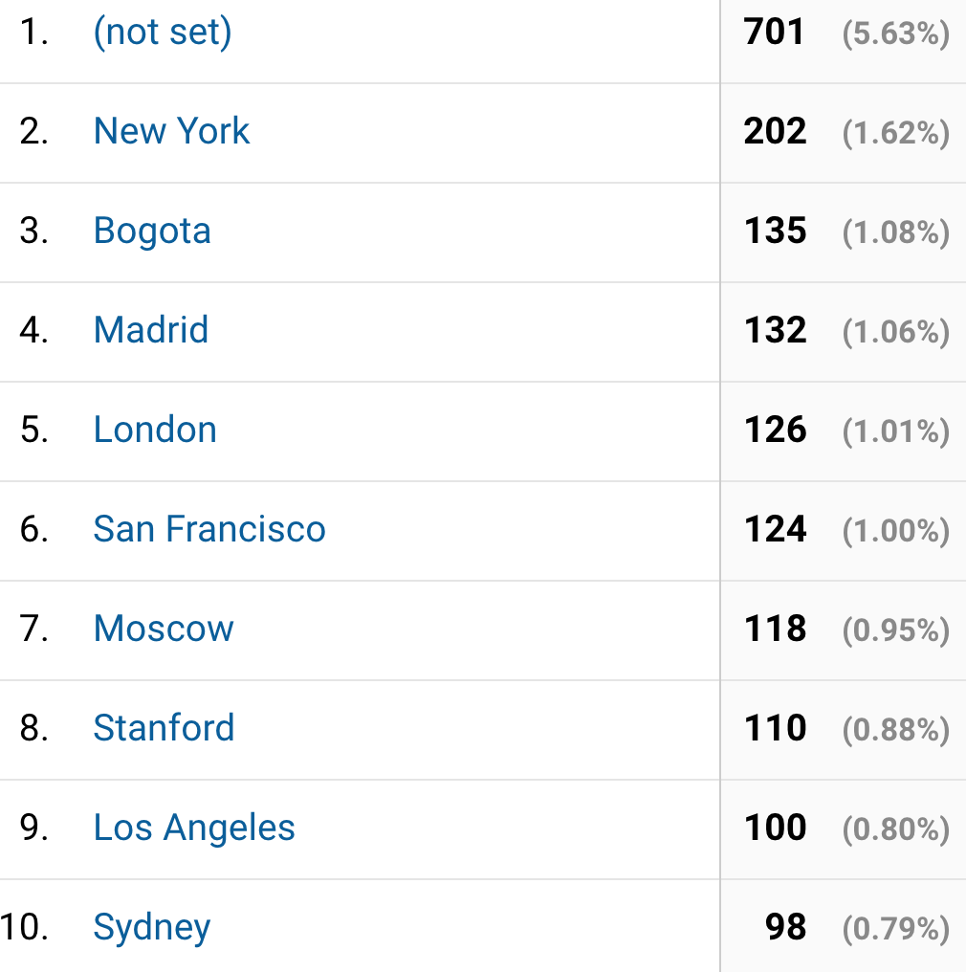

Slide 87
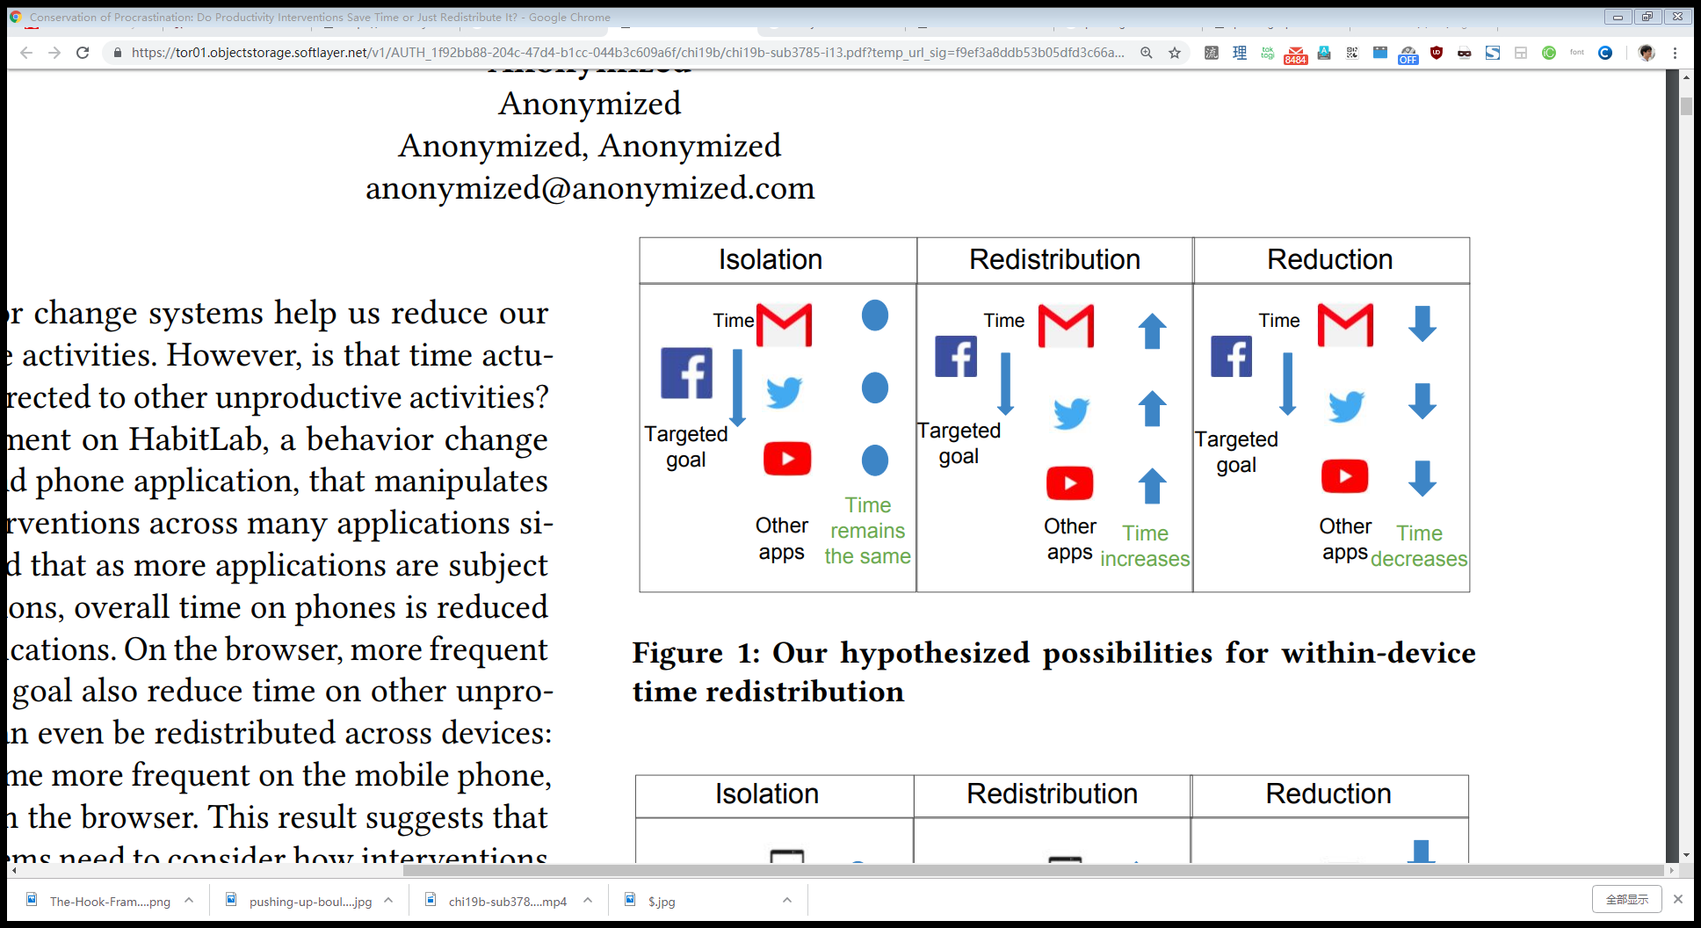
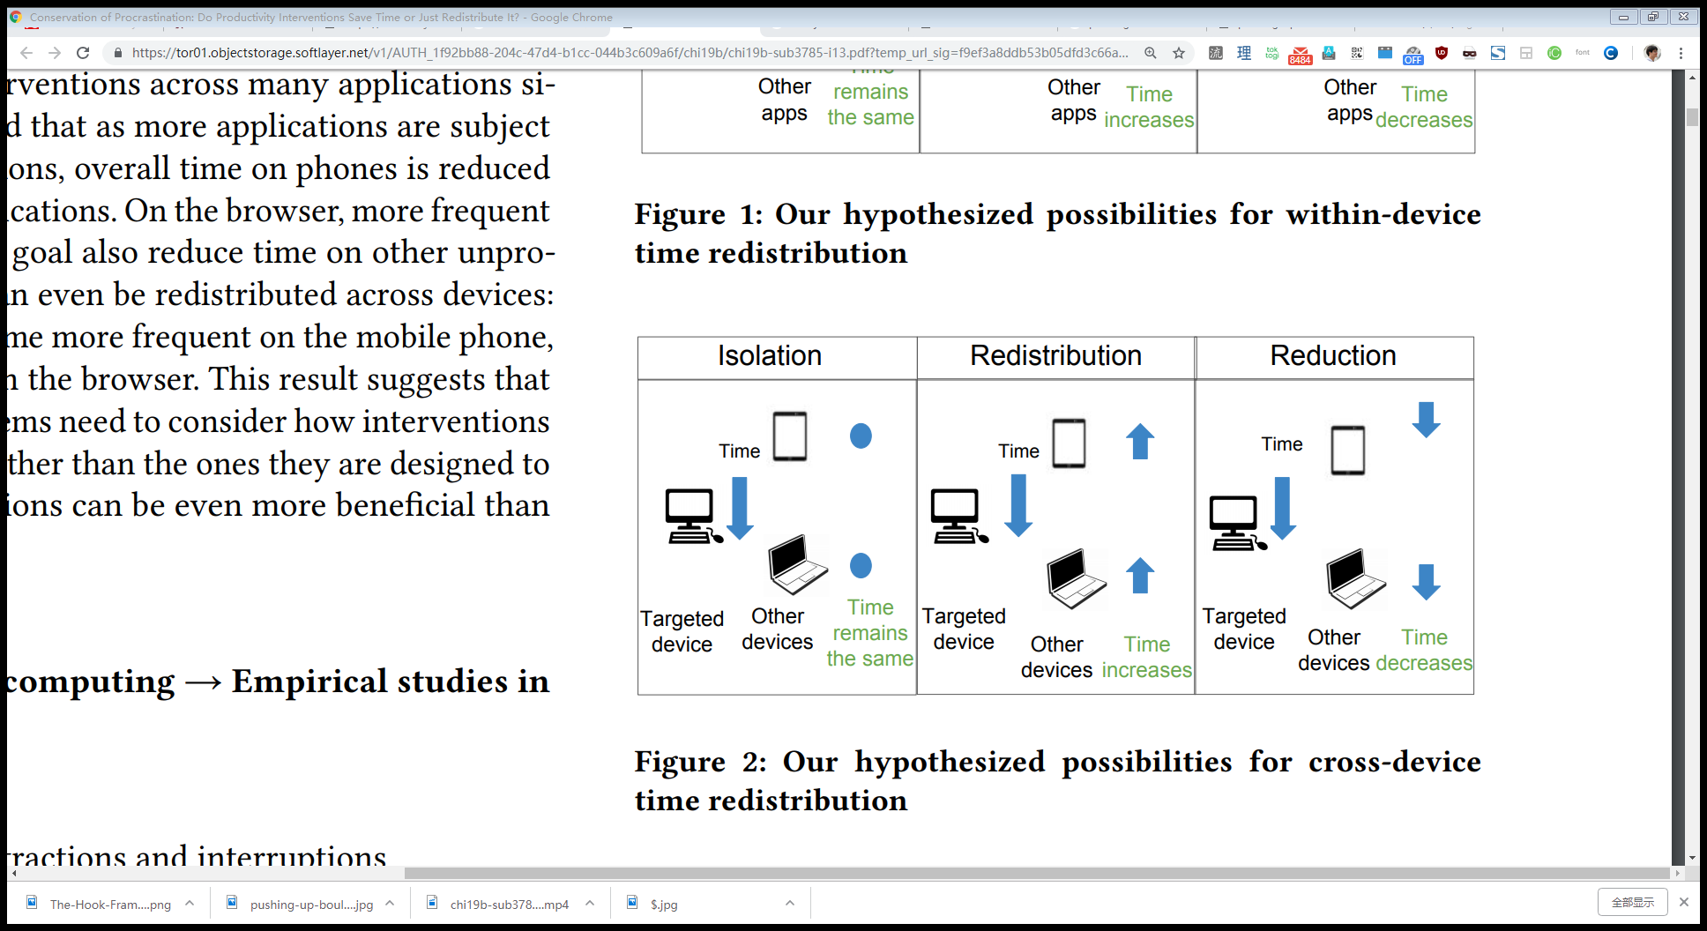
Conclusion
Does reducing time via interventions influence time spent elsewhere?
Within-device, we observe reduction on browser, but not mobile
Perhaps due to goal sites driving traffic to other sites
Cross-device, we observe no effects
Mobile
Browser
Mobile → Browser
Browser → Mobile

Slide 88
Conclusion
Does reducing time via interventions influence time spent elsewhere? 3 possibilities:
No effect (isolation)
Increases time spent elsewhere (redistribution)
Decreases time spent elsewhere (reduction)
Within-device, we observe reduction on browser, but not mobile
Perhaps due to goal sites driving traffic to other sites
Cross-device, we observe no effects

Slide 89
RQ2: Do interventions on one device influence time spent on the other device?
Mobile → Browser
Browser → Mobile

Slide 90
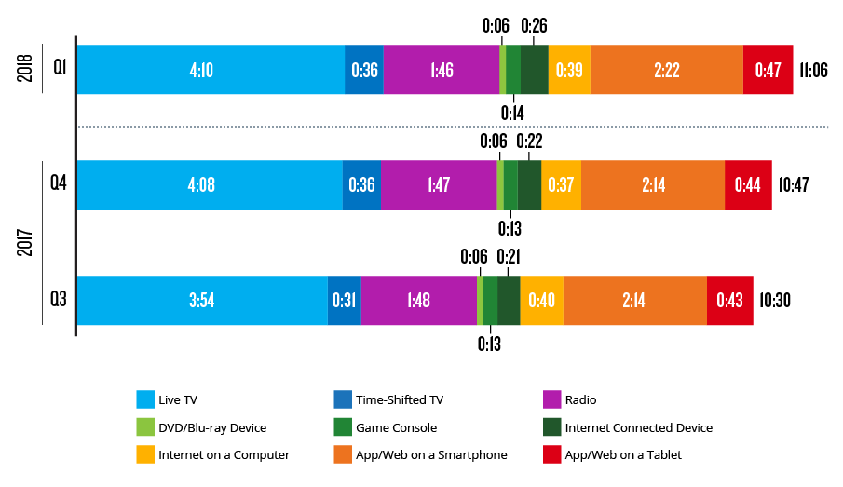
US adults spend 4.2 hours each day
browsing the web and using phone apps
Q1 2018 Nielsen Total Audience Report

Slide 91
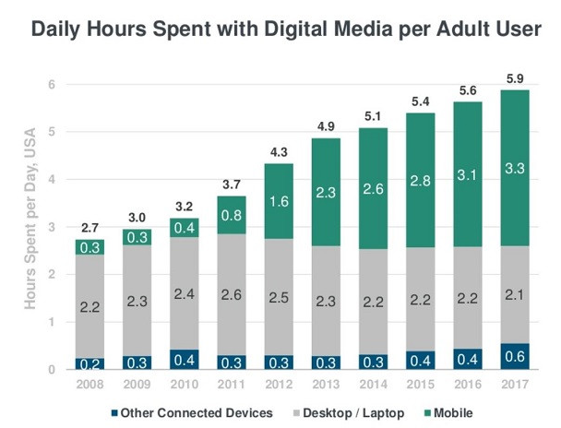
People spend increasing amounts of time online
Average US adult spends 5.9 hours per day with digital media

